Slide 1
VARIOUS ISLAMIC MICROFINANCE MODELS AND ITS EFFECTIVENESS ON POVERTY ALLEVIATION

Slide 2
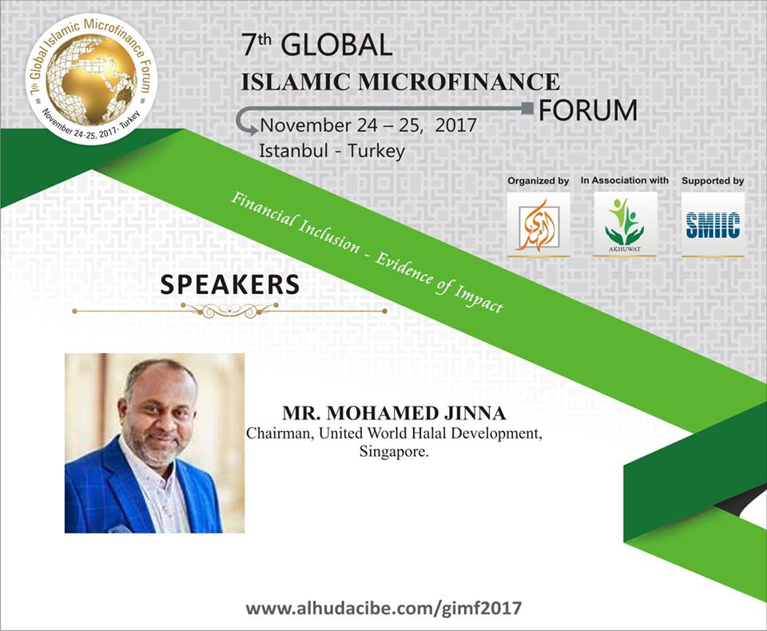

Slide 3
INTRODUCTION
Microfinance is, “A program that offers small amount of loans to poor people for self-employment projects that generate income in allowing them to take care of themselves and their families.”
Started in Bangladesh in 1976 responding to the wide spread famine in 1974.
Islamic microfinance is, “ Confluence of two
rapidly growing
industries: Microfinance and
Islamic finance”
- Consultative Group to Assist the Poor (CGAP).

Slide 4
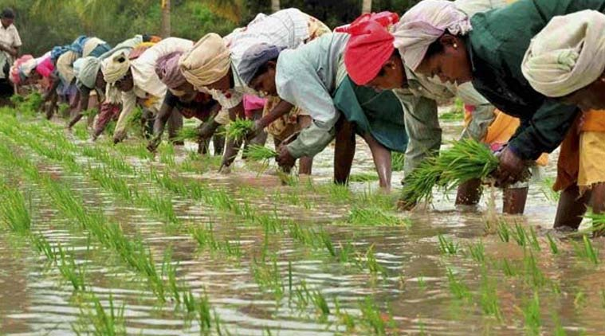
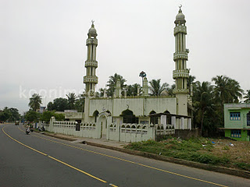
BaithulMal – Koonimedu, India
Uses the model of Qard al Hasan (benevolent loan) to the poor and destitute.
Average loan size USD 100
Has repayment rate of 99.89%

Slide 5
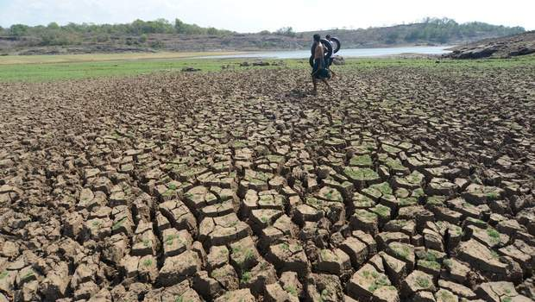
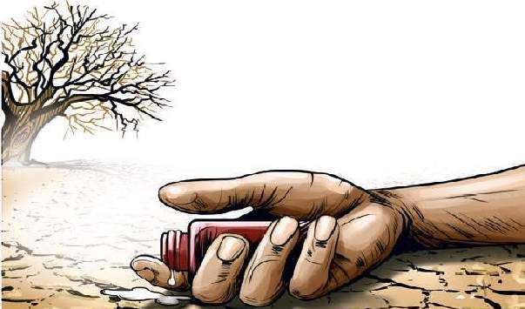
BaithulMal – Koonimedu, India

Slide 6
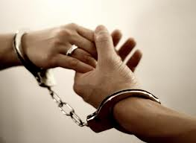
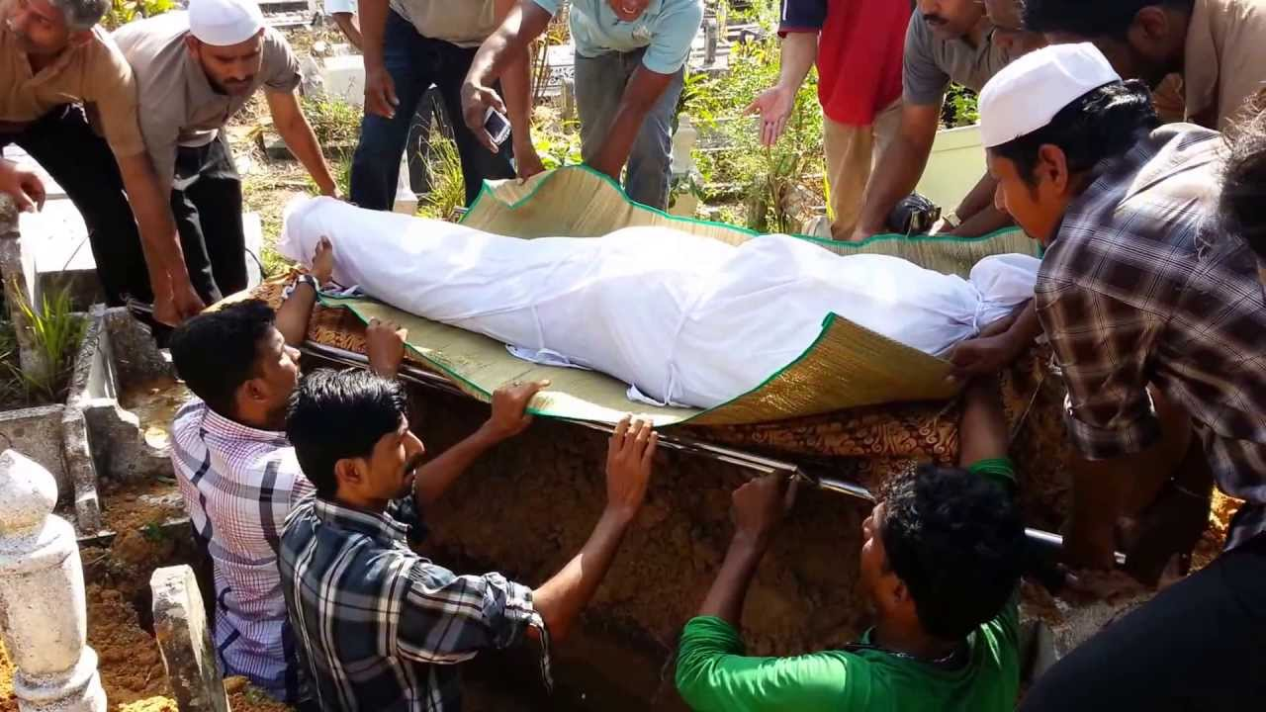
TYPES OF ASISTANCE (PRODUCT)

Slide 7
TYPES OF ASISTANCE (PRODUCT)
Fisherman Loan
Education Loan
Health Loan
Housing Loan
Emergency/Medical Loan
Marriage Loan
Farmers Loan

Slide 8
TYPES OF ASISTANCE (PRODUCT)
Comprises 91% of loan portfolio
Family Enterprise Loan
Entire family must get involved
Amount ranges from USD 100 USD 250
Liberation Loan
Rescue people from interest-bearing loan
The limit of the loan is up to USD 500.

Slide 9
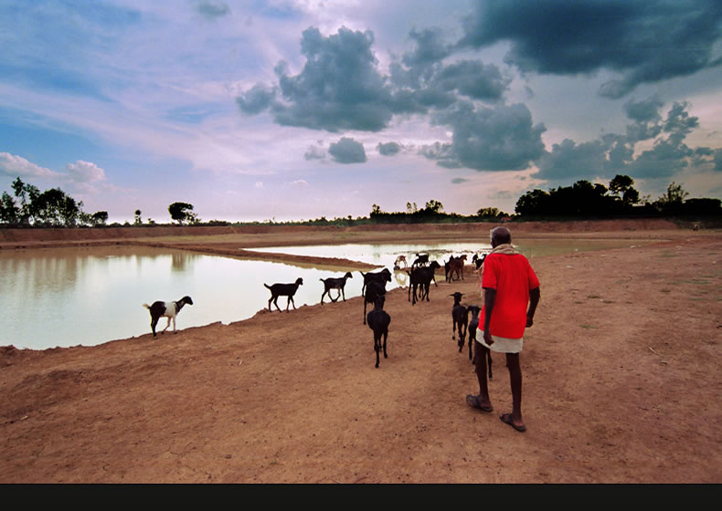
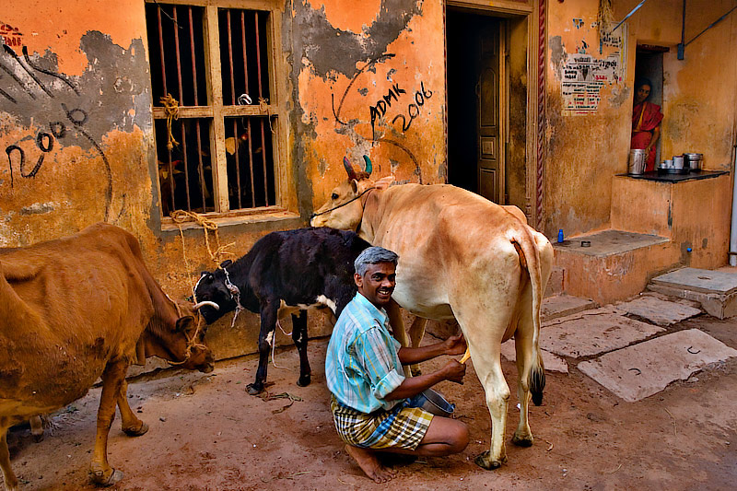
BaithulMal – Koonimedu, India
123 people contributed the seeing fund to Baithulmal
USD 20,000 seeing fund has been raised
300 families benefited so far
20 Small / Tiny / Cottage industries developed
Qurban Goat / Sheep farming
Milk distribution center
Grocery shop

Slide 10
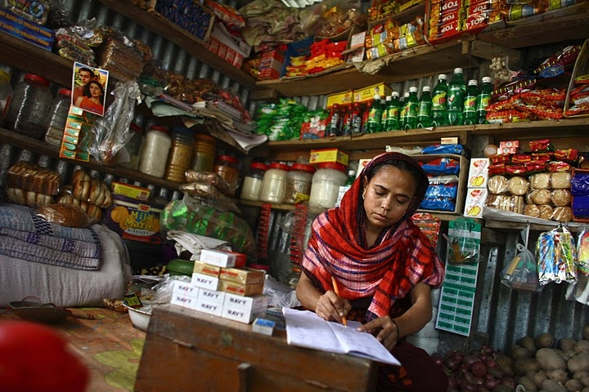
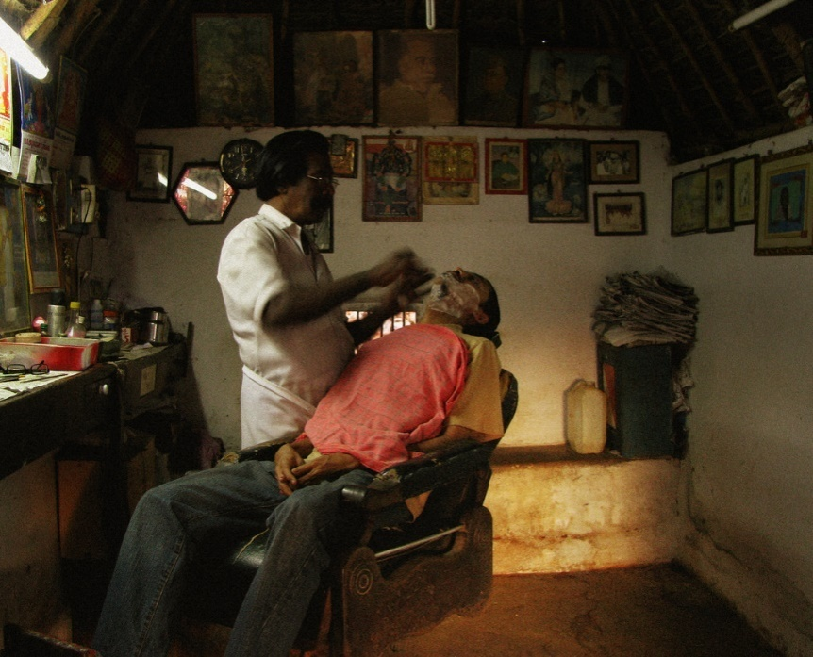
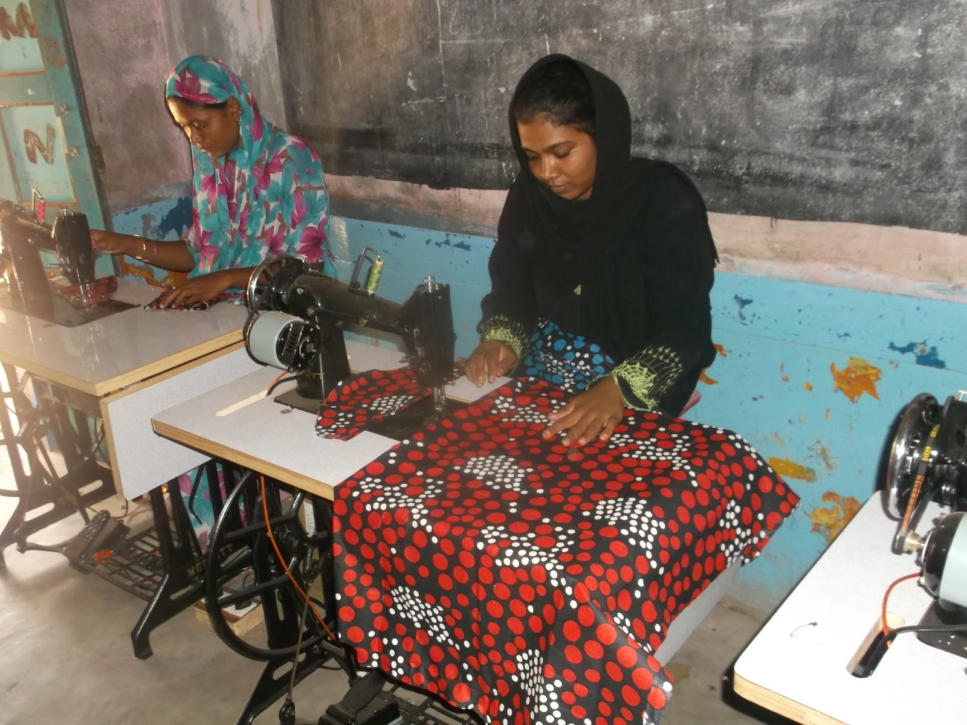
BaithulMal – Koonimedu, India
Grocery shop
Women's Trailering shop
Barber Shop
Fisherman loan
Farmer loan

Slide 11
LENDING METHODOLOGY
Eligibility Criteria
Process of Lending
No discrimination on the basis of cast, gender or religion.
Person should be below poverty line.
Should have a reliable social capital.
Should not be involved in any illegal activities.
BaithulMal financing pivots around mosque based arrangement.
Checks the eligibility criteria of the people applied for loan.
Uses collateral-free group and individual financing based on mutual guarantees. The borrower’s family members are requested to get involved with the loan process and two guarantors are asked to present.
Money is distributed with free administration fee.

Slide 12
RISK MANAGEMENT
Utilization of religion and culture as risk management tool.
Once the loan has been disbursed, the Unit Manager monitors the client with regular. visits to his residence and place of work.
Having two guarantors for each client

Slide 13
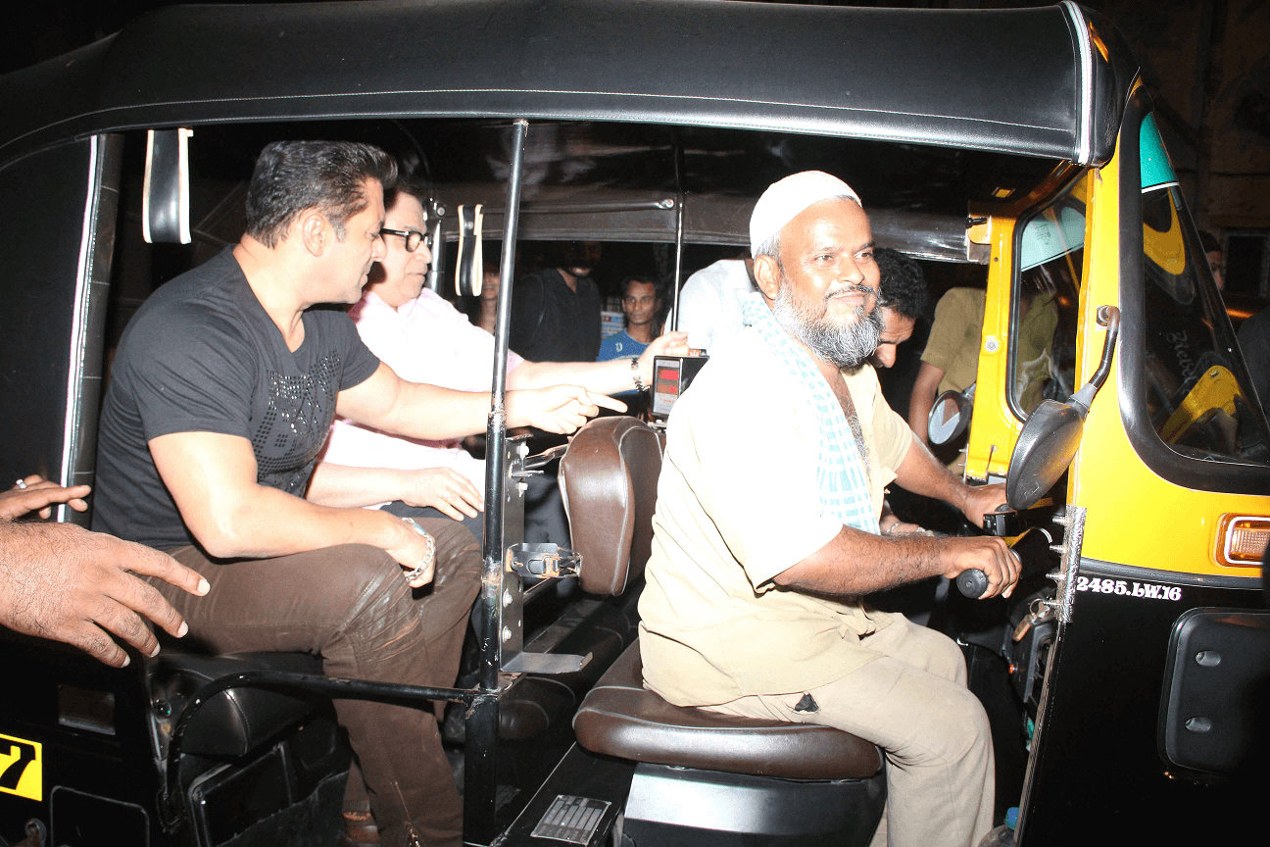
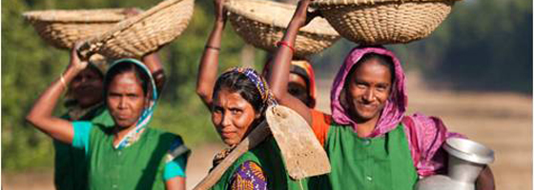
RURAL DEVELOPMENT SCHEME

Slide 14
IMMEDIATE NEEDS
Immediate need to Introduce
MICRO FINANCING - IDB
INTEREST FREE LOANS
Creating Muslims Global Business Centre
THINK TANK
FUNDING SOURCE
BUSINESS IDEAS
GOVT ASSISTANCE ETC
to promote young entrepreneurs for Halal Products

Slide 15
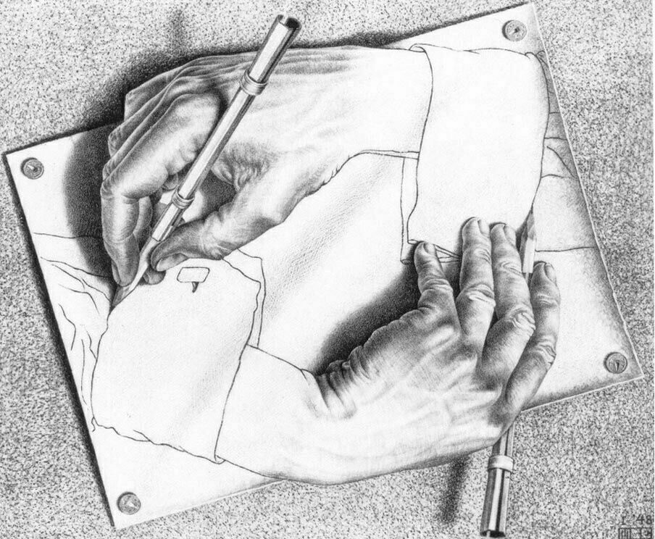
WHAT IS MISSING ??
When there is no Opportunity, Create It !!
If Opportunity Doesn’t Knock, Build A Door !
Missing is
WE
We Should Start Creating Ourselves

Slide 16
UNWHD – SOFTWARE'S

Slide 17
WAQF SYSTEM

Slide 18
BAITHULMAL SYSTEM

Slide 19
Hopefully there is no more secrets to be united & march towards the holistic & meaningful Development ! Everything Revealed !! Its Time for Us, Specially to the
Young Entrepreneurs - Islamic Microfinancing System
We are Khalifahs
We are Accountable, We are Responsible

Slide 21
CONCLUSION
The models have issues which can be fixed for the expansion and sustainability of the industry.
More concentration should be given on equity-based products than debt-based to reduce cost and maximize benefit.
Islamic microfinance institutions should not be aggressive in making profit as they are dealing with the poor and needy.
More non-bank Islamic finance institutions should join the Islamic microfinance market as they will be able to tap areas which the banking institutions are failing
Ultimately, Islamic Groups should come out of this vicious cycle of perpetual poverty created by conventional microfinance and come closer to the main objective of microfinance i.e. alleviation of poverty.

Slide 22
“Truly, God does not change the condition of a people until they change what is in themselves.”
(Quran 13:11)
THE CLOCK STARTS NOW

